Slide 1
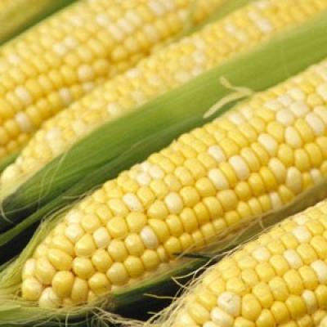
CORN
By:Varga Boglárka

Slide 2
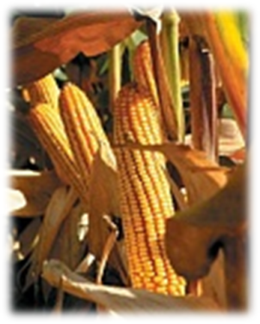
Origins of Corn
A large number of Indian myths deal with the origin of corn and how it came to be grown by humans. Many of the tales center on a "Corn Mother" or other female figure who introduces corn to the people.
In one myth, told by the Creeks and other tribes of the southeastern United States, the Corn Woman is an old woman living with a family that does not know who she is. Every day she feeds the family corn dishes, but the members of the family cannot figure out where she gets the food.
One day, wanting to discover where the old woman gets the corn, the sons spy on her. Depending on the version of the story, the corn is either scabs or sores that she rubs off her body, washings from her feet, nail clippings, or even her feces. In all versions, the origin of the corn is disgusting, and once the family members know its origin, they refuse to eat it.
deity god or goddess
The Corn Woman solves the problem in one of several ways. In one version, she tells the sons to clear a large piece of ground, kill her, and drag her body around the clearing seven times. However, the sons clear only seven small spaces, cut off her head, and drag it around the seven spots. Wherever her blood fell, corn grew. According to the story, this is why corn only grows in some places and not all over the world

Slide 3
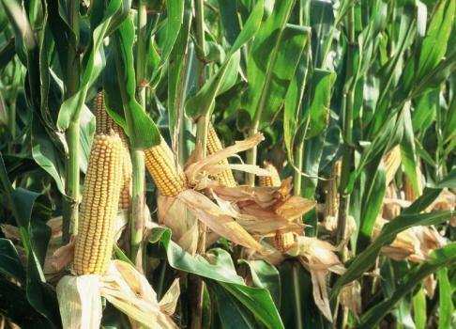
In another account, the Corn Woman tells the boys to build a corn crib and lock her inside it for four days. At the end of that time, they open the crib and find it filled with corn. The Corn Woman then shows them how to use the corn.
Other stories of the origin of corn involve goddesses who choose men to teach the uses of corn and to spread the knowledge to their people. The Seneca Indians of the Northeast tell of a beautiful woman who lived on a cliff and sang to the village below. Her song told an old man to climb to the top and be her husband. At first, he refused because the climb was so steep, but the villagers persuaded him to go.
When the old man reached the top, the woman asked him to make love to her. She also taught him how to care for a young plant that would grow on the spot where they made love. The old man fainted as he embraced the woman, and when he awoke, the woman was gone. Five days later, he returned to the spot to find a corn plant. He husked the corn and gave some grains to each member of the tribe. The Seneca then shared their knowledge with other tribes, spreading corn around the world.

Slide 4
Summer Corn Salad’s recipe:
Ingredients
6 ears corn, husked and cleaned
3 large tomatoes, diced
1 large onion, diced
1/4 cup chopped fresh basil
1/4 cup olive oil
2 tablespoons white vinegar
salt and pepper to taste
Directions
1st step: Bring a large pot of lightly salted water to a boil. Cook corn in boiling water for 7 to 10 minutes, or until desired tenderness. Drain, cool, and cut kernels off the cob with a sharp knife.
2nd step: In a large bowl, toss together the corn, tomatoes, onion, basil, oil, vinegar, salt and pepper. Chill until serving.

